Slide 1
Facial verification in customer banking
In this presentation I will be discussing a project about the development of facial verification in customer banking. Over the next few slides I will be discussing the overall aim of this project and the risks associated with this technology. As well as, provide technical documentation and the stakeholders involved.

Slide 2
Overall aim
To create a more user friendly and secure way to protect our bank accounts for everyone.
This technology reduces the need for extensive security technology to provide verification and authentication and instead, allows you to provide this evidence by looking into a camera.
Have you ever forgotten your passcode or ping? There is no need to worry anymore, a s I have got the solution.
Advantages and disadvantages in terms of security
Advantages | Disadvantages
More reliable than humans, as they do not need to recognise facial images. Making a false identity easier to recognise. | This form of technology is still advancing and becoming faster at processing information.
More reliable than behavioural systems. | Reduces privacy. ‘Everyone appears to be watching everyone else’
Provides 24 hour security and is used by most of the major banks. | Increases the risk of security breaches, as the technology is on in it’s first stages of development.
Uses facial features which are mapped. | A diagram with an exact replica is in a database.
Uses a variety of facial features for identification and verification.
Notes:
Facial recognition may be unpopular among customers as they do not know the benefits of this technology.
References:
K. Delac and M. Grgic, "A survey of biometric recognition methods," Proceedings. Elmar-2004. 46th International Symposium on Electronics in Marine, Zadar, Croatia, 2004, pp. 184-193.

Slide 3
Exciting user stories from customers
As a <Customer>, I want <facial recognition software> so that <I do not have to keep forgetting my passcode>
I want <improve the security of mobile banking apps> so that <the company is not left behind by the latest technological advancements>
As a <Customer> this new technology has allowed me to access my bank accounts quicker and easier than before.
As a <Business customer> I believe this is an exciting new change and would be willing to invest in this technology in the future, or merge my company with your company.
As both a <Member of staff and a customer> I am happy to have had the chance to assist with the development of this stimulating development and hope the company continues to do well.
Notes:
References:
HSBC unveils facial-recognition banking for corporate customers

Slide 4
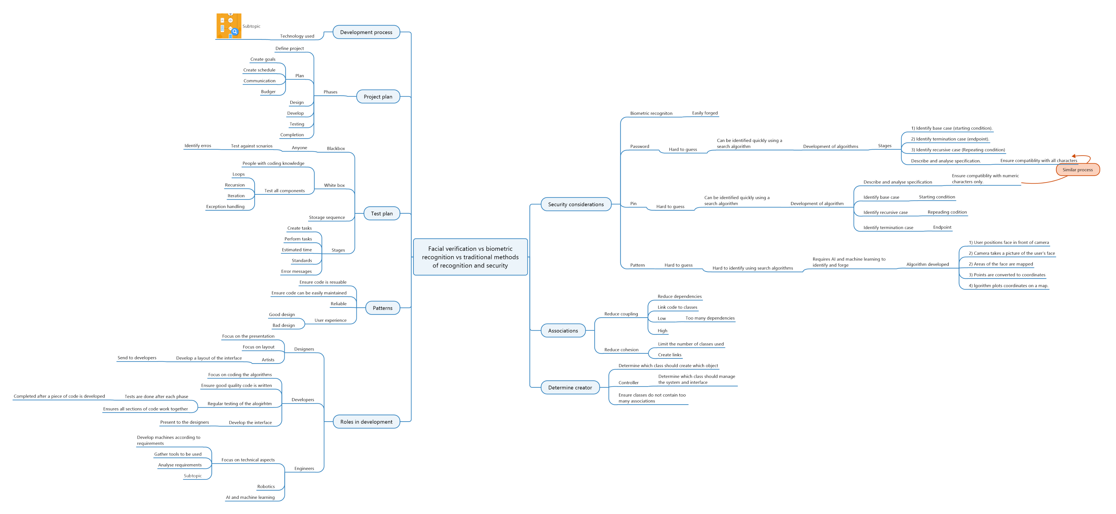
Project management plan

Slide 5
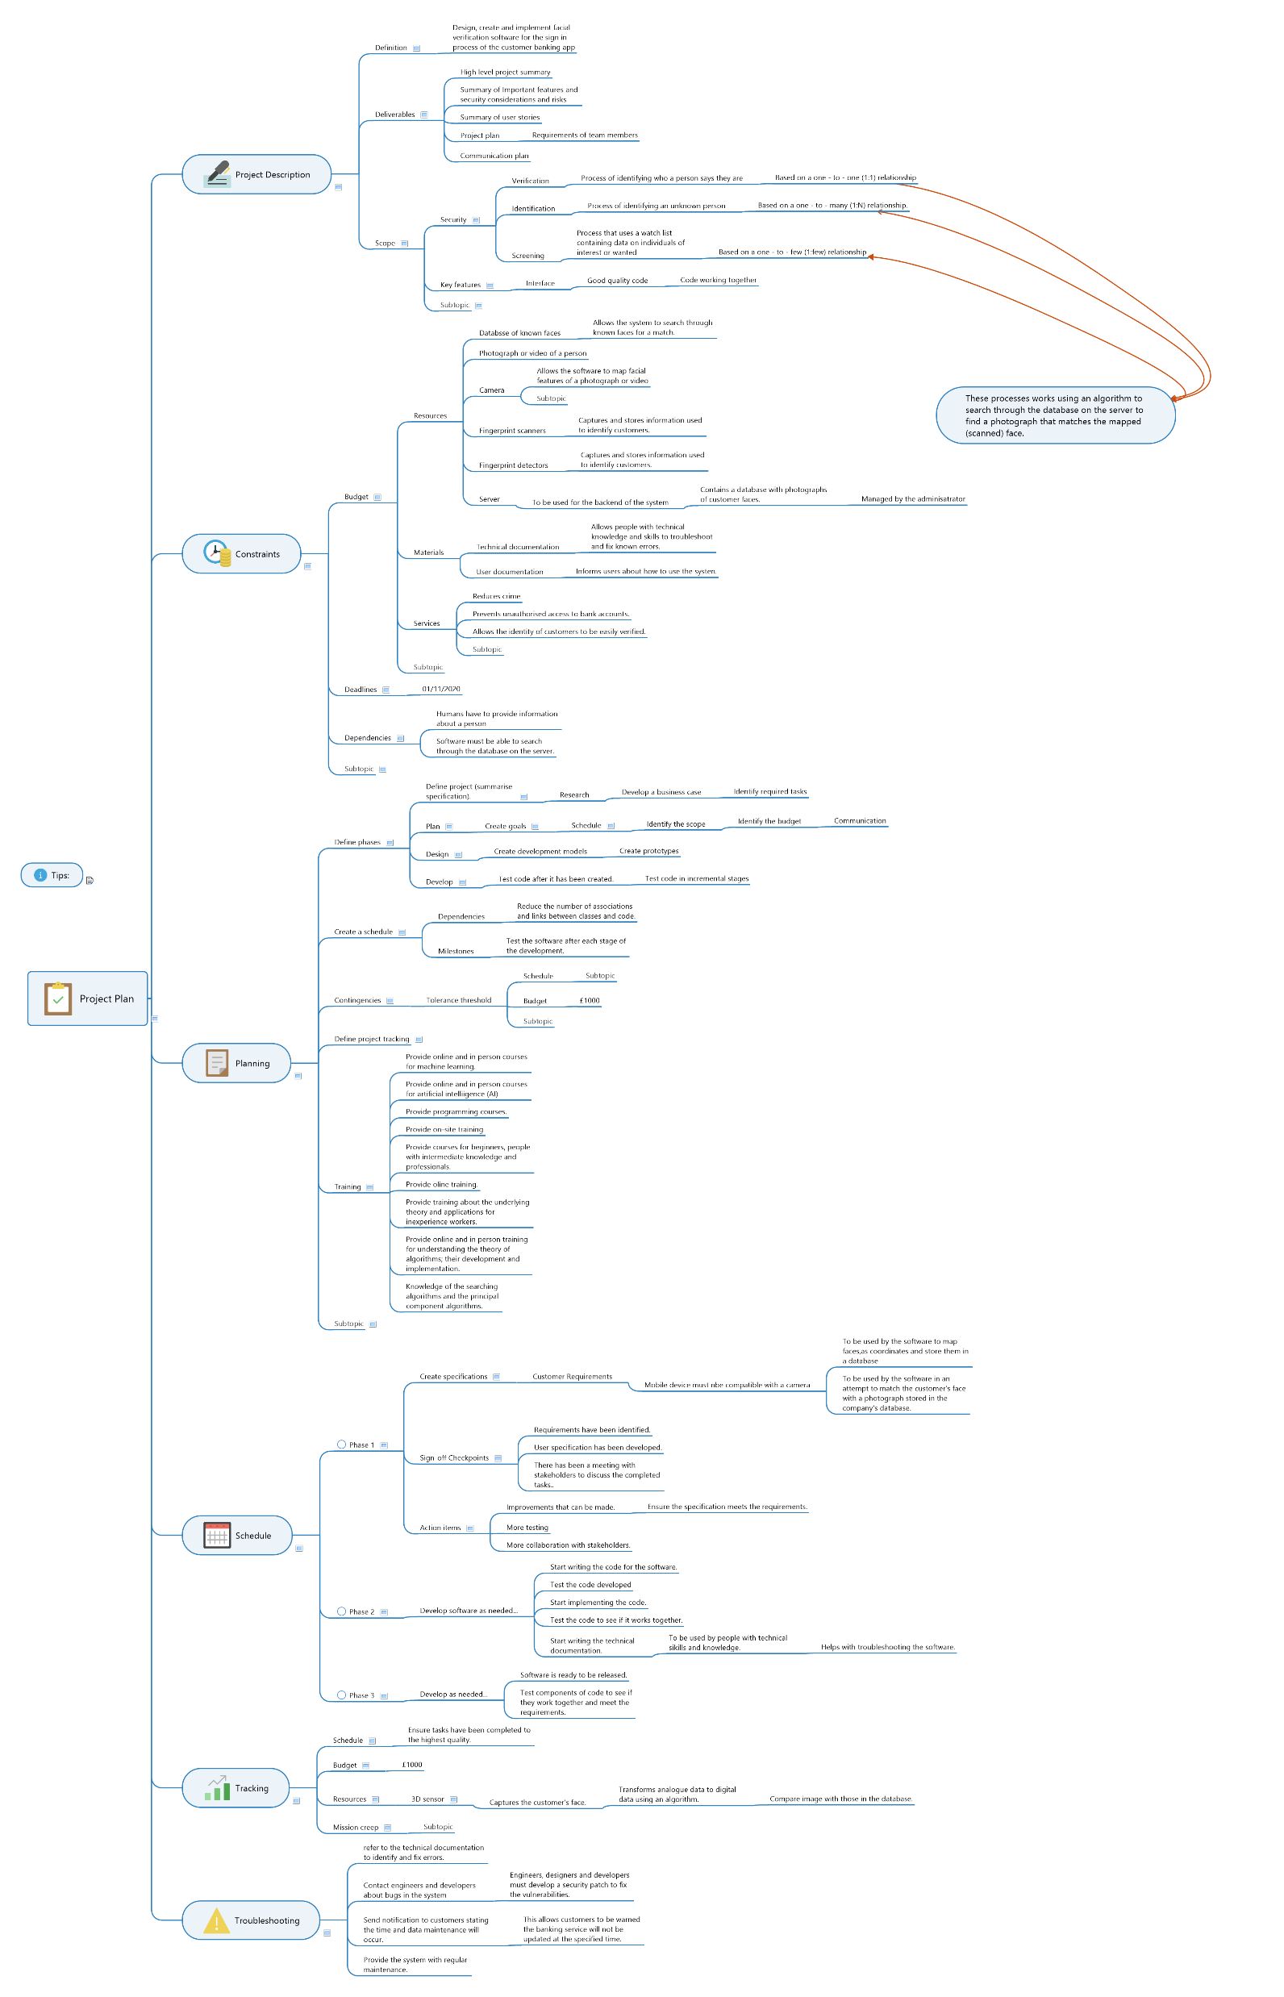
Project management plan

Slide 6
User stories
User stories | Acceptance criteria
As a <customer> I do not want to <enter my passcode> so that <my time spent using the app is reduced>.
As a <customer> I want <a quicker way to verify my identity> so that <the sign in process is quicker>
As a <customer with a joint account> I want to <add my partner’s face to the sign in process> so that <they are able to sign in using their face>
As a <customer with a business account> I want <a quicker way to change the person who owns the account> so that <the account will have a different administrator>
As a <member of staff using mobile banking> I want <a more secure way to verify my identity> so that <my account remains as secure as possible>

Slide 7
Communications plan
Communication type | Description | Frequency | Format | Participants | Deliverables | Owner
Weekly status report | Inform staff about tasks that have been completed and still need finishing | Weekly | Email | Project sponsor Team Stakeholders | Status report | Project manager
Project monthly review | Review status and actions required. | Weekly | In person | Team working on project Stakeholders Project sponsor | Presentation with status and percentage of tasks completed. | Project manager
Weekly team meeting | Review action plan and status. | Weekly | In person | Project team | Upload action log. | Project manager
Sprint demo | Present the phases in the sprint | When necessary. | Beginning and end of every sprint | Project team | Technical design review | Technology department

Slide 8
Communications plan continued
Communication type | Description | Frequency | Format | Participants | Deliverables | Owner
Technical design review | Review of technical designs and work associated with the project. | When necessary | In person/video call | Project team | Technical design review | Technology department
Scrum | Review of work done day before, work to do today and any problems. | Daily | In person/video call | Project team | Scrum task board Burndown chart Gantt chart | Project manager

